Slide 1
What are atoms, elements and compounds?

Slide 2
In this Smart Lesson, you will learn about atoms and how they combine in different ways to form either elements or compounds.
By the end of the lesson you should be able to describe the differences between atoms, elements and compounds.

Slide 3
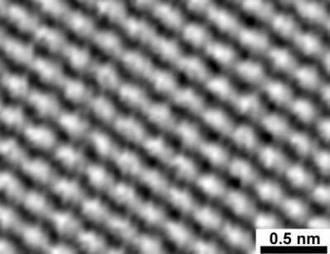
Atoms are the most basic building block of all matter. They are so tiny that they cannot be seen except with a powerful microscope called a scanning tunnelling microscope (STM).

Slide 4

Watch this video (2:32) to find out how scientists have managed to see individual atoms of platinum!

Slide 5
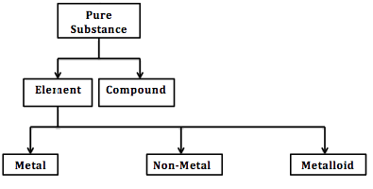
Atoms can combine in different ways to produce different types of substances. The types of substances you need to know about are elements and compounds.

Slide 6
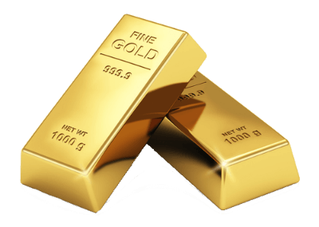
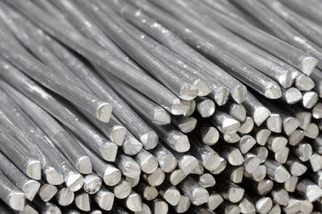
An element is a substance that contains only one type of atom.
For example, a lump of pure gold metal contains only atoms of gold, and a lump of aluminium metal contains only atoms of aluminium.

Slide 7
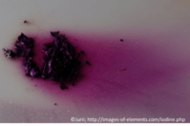

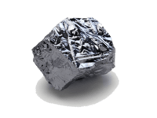
Elements can be metals, non-metals, or metalloids. These different types of elements have different properties, which are determined by the type of atoms that make them up.

Slide 8
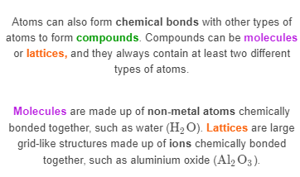
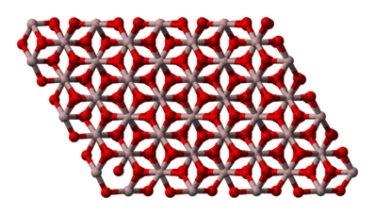
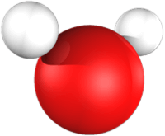

Slide 9
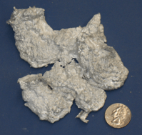
The properties of compounds are very different from the properties of the elements that make them up.
For example, aluminium oxide is a white crystalline solid, while elemental aluminium exists as a silver coloured metal and oxygen exists as a colourless gas.
Aluminium metal
Aluminium oxide

